Slide 1
Welcome, The Garden Blooms
-Aastha Solanki

Slide 2
Introduction
Hello,Everyone I’m Aastha Solanki, and
today I’m talking about Flower shop.
We offer a wide selection of fresh flowers with local and nationwide delivery.
In my presentation,I’II show you:
What is Description.
Why it’s importance.
What id their scope.

Slide 3
Importance
Nature’s gifts are abundant, and flowers are one of its finest.
Flowers provide food in the form of nectar and pollen for many insects and animals.
Some flowers have medicinal properties that can be used to create natural remedies.
Flowers add color and beauty to homes and gardens.

Slide 4
Description
A wide variety of individual flowers such as roses, sunflowers, and lilies.
Ornamental plants for home or garden use.
Supplying flowers and plants to beautify homes and other spaces.
Taking care of the flowers by watering, fertilizing, and providing proper sunlight.
Professionally arranging flowers into aesthetically pleasing bouquets and displays.

Slide 5
Scope
Selling fresh flowers and arrangements directly to customers for daily needs, gifts, and local celebrations.
Using flowers to create therapeutic experiences for individuals.
local sales of fresh flowers for events like birthdays and weddings, online orders, and specialized services like corporate arrangements

Slide 6
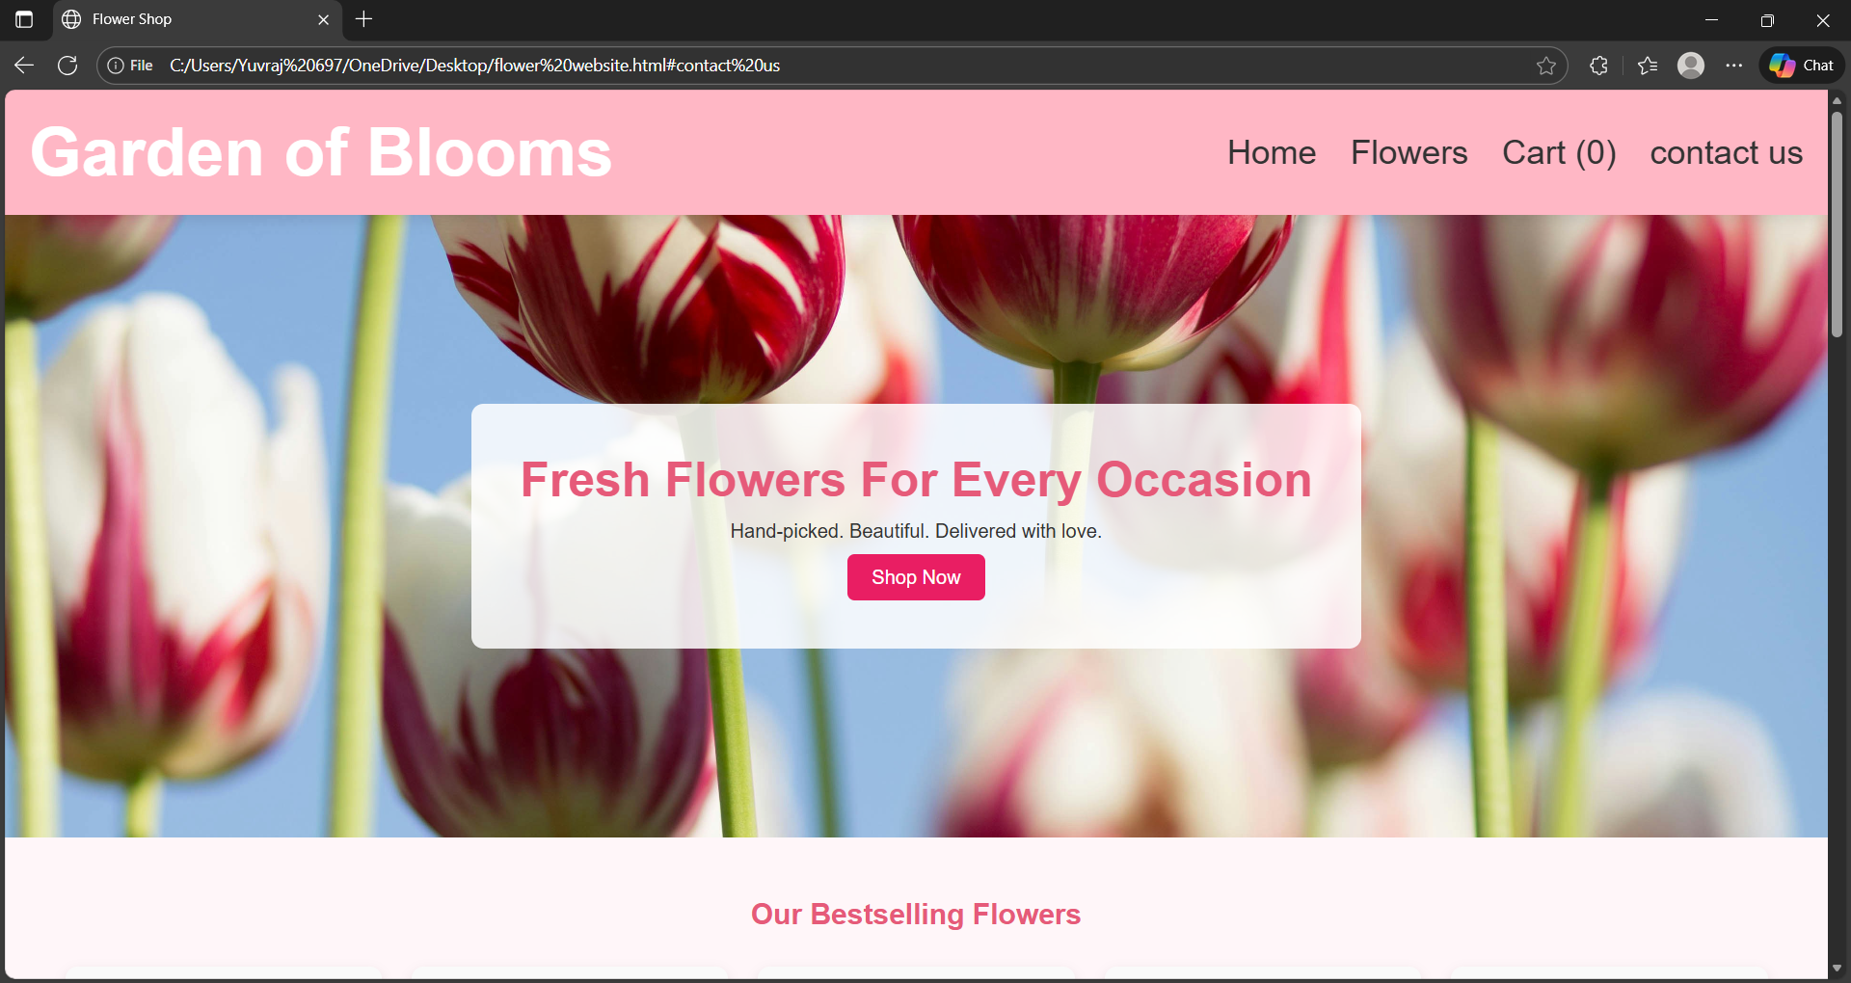

Slide 7
The image shows the homepage of a flower shop website called Garden of Blooms. At the top, a pink navigation bar displays the shop’s name on the left and menu options—Home, Flowers, Cart, Contact Us—on the right.
The background features a large, vibrant photo of red and white tulips, creating a fresh and welcoming look.

Slide 8
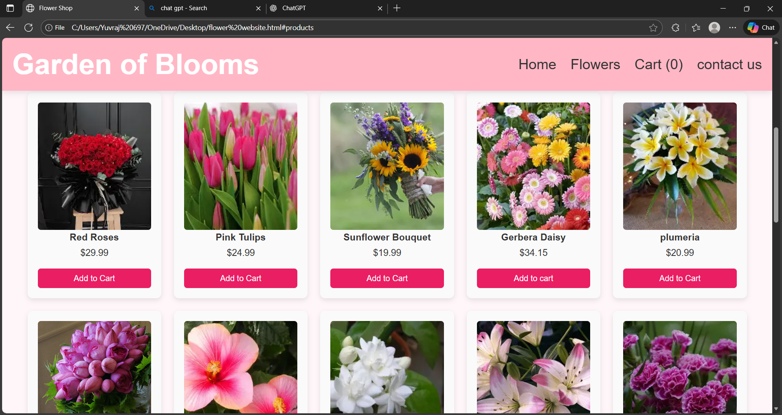

Slide 9
Below the header, the page displays a grid of flower products, each inside a white card with rounded corners. Every product card includes:
The flower name(e.g:, Red roses, pink tulips,sunflower Bouquet,gerbera daisy,plimeria)
A price
A pink “Add to cart”button

Slide 10
Thank you…
-Solanki Aastha

